Slide 1
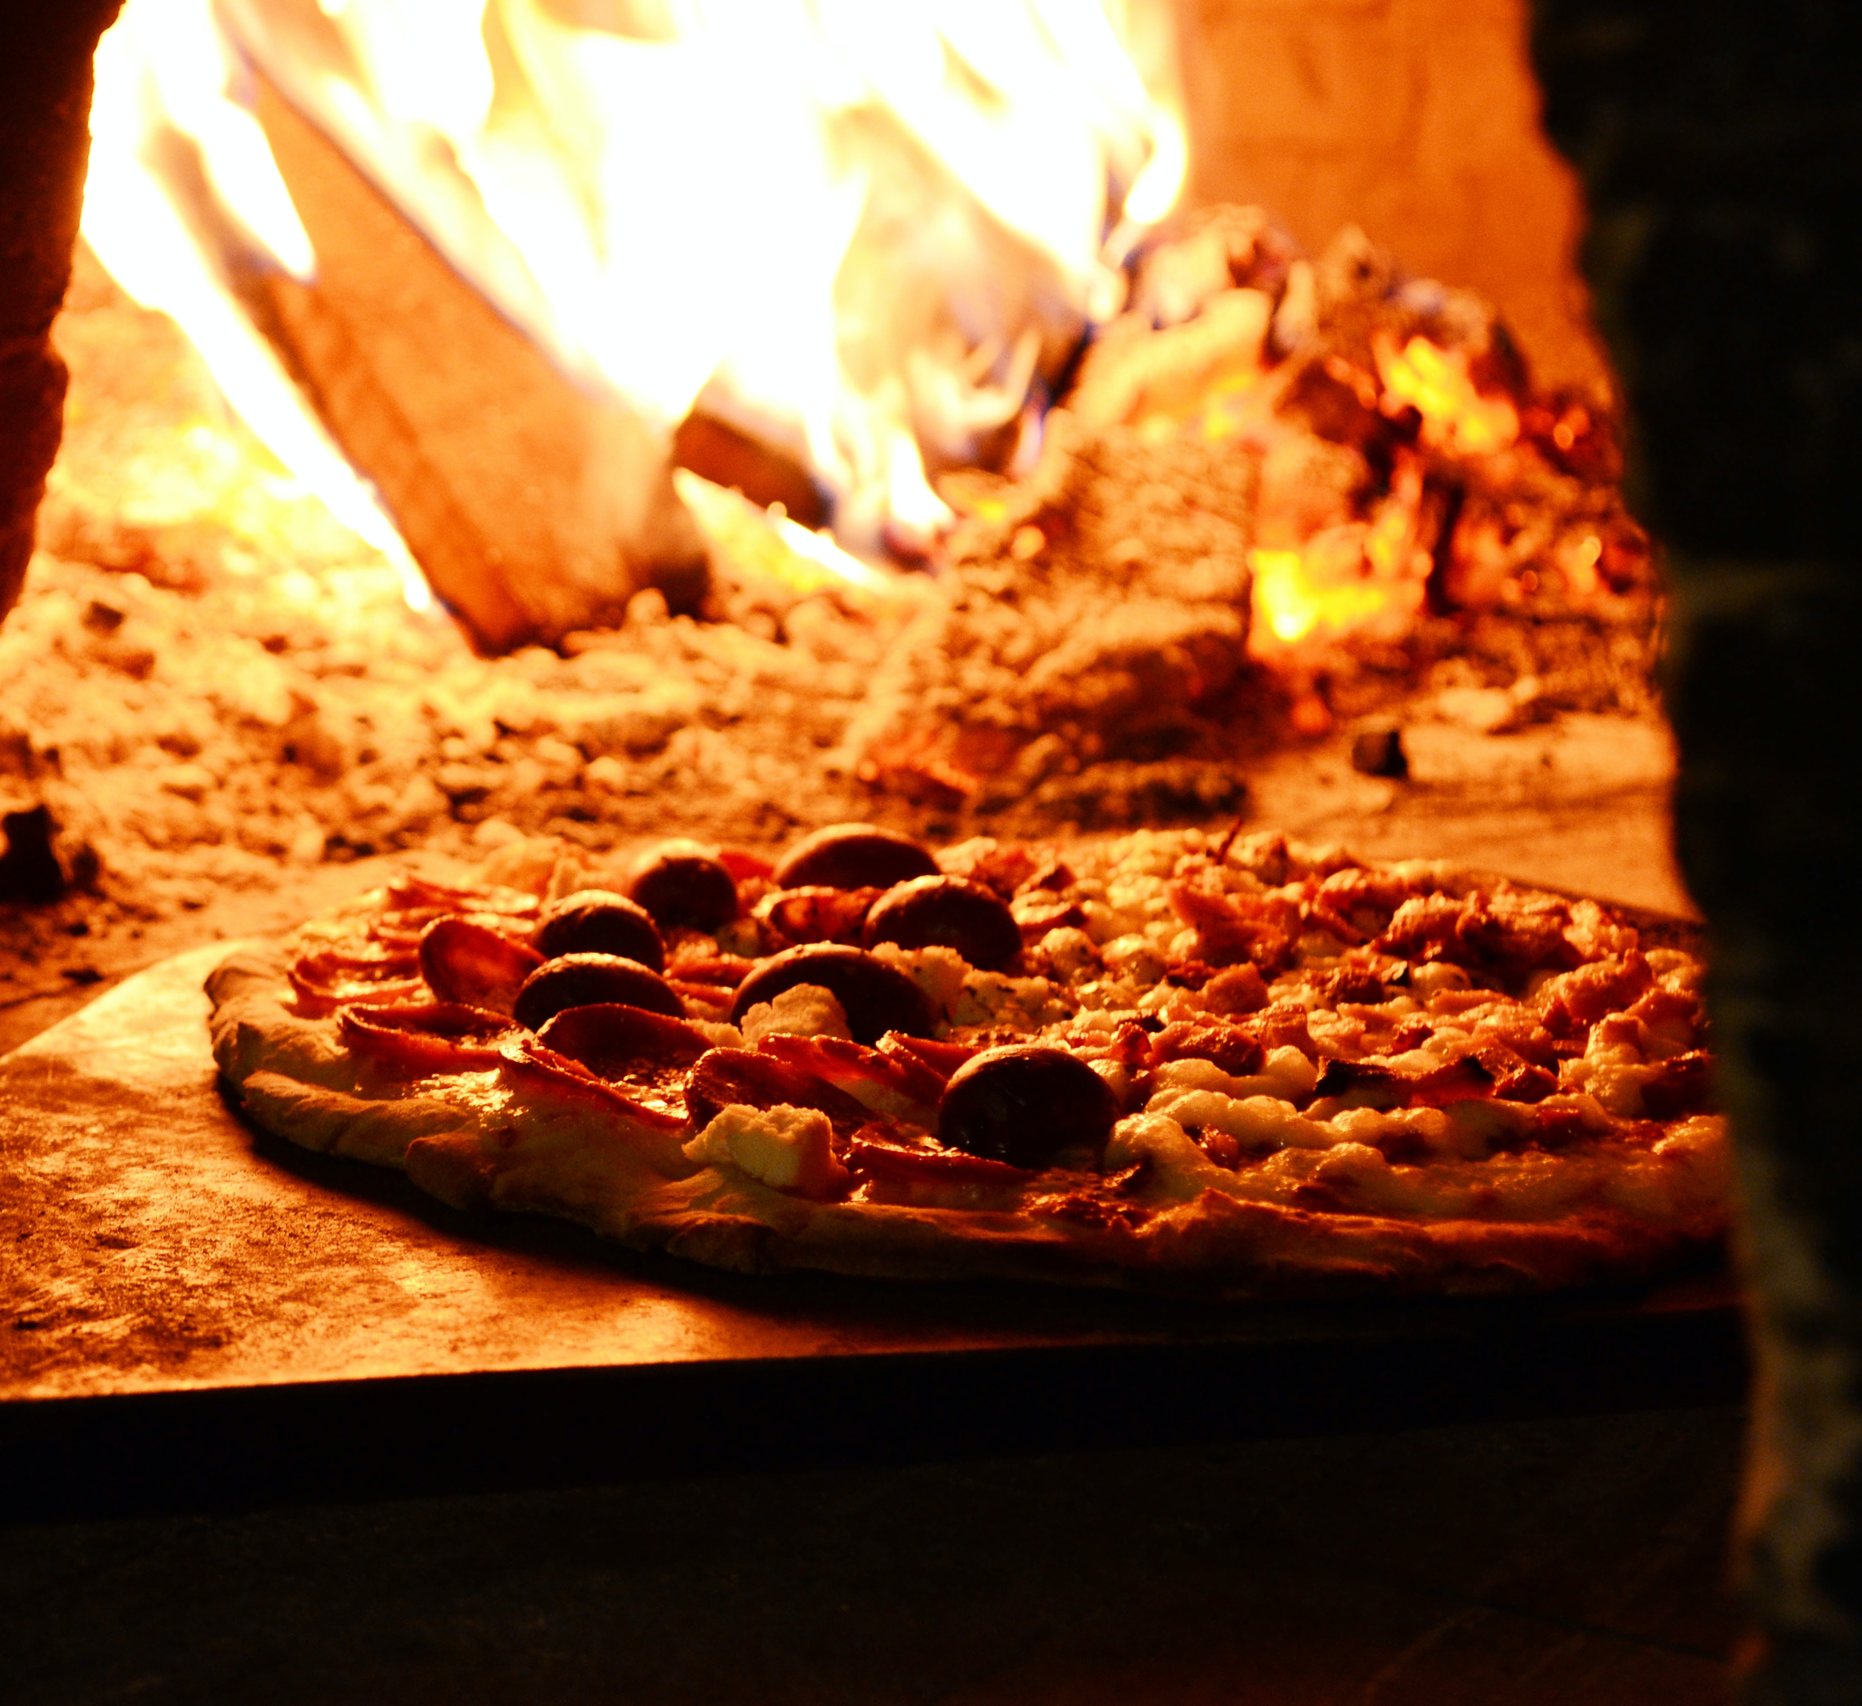
Presenting A modernized mario and Luigi’s pizzeria
Renewed in 2022
Notes:
Dimi: Good morning motherfuckers. We are going to demolish this presentation

Slide 2
Our team
Dimitar
Nadiem
Nicholas
Ruben
Atanasov
Baloum
Gusnawan
Bekema
Notes:
Dimitar: These are my slaves.

Slide 3
Tradition
+
TECHNOLOGY
=
SUCCESS
Notes:
Dimitar: And today we are going to show you why TRADITION pause click + TECHNOLOGY pause click = SUCCESS

Slide 4
MARIO's PIZZERIA: HOW DID IT WORK?
1
2
3
4
5
customer arrives
cashier takes order
cashier shouts order
cooker writes order
cooker starts cooking
10
9
8
7
6
cashier serves pizza
cashier takes pizza
cooker rings bell
pizza is ready
customer eats pizza
Notes:
Jason: And we’re going to start by showing you how pizzeria da mario has been working for many years now and later show you our analysis.
We’ve broken down the workflow in 10 clear steps.
So the steps are: a customer arrives and enters the pizzeria. The cashier asks him what the would like to order, the cashier then shouts the order at the cooker who then starts preparing and cooking the pizza on the oven. When the pizza is finally ready, the cooker rings a small bell to alert the cashier. The cashier comes, takes up the pizza and serves it to the customer’s table. The customer finally starts eating.

Slide 5
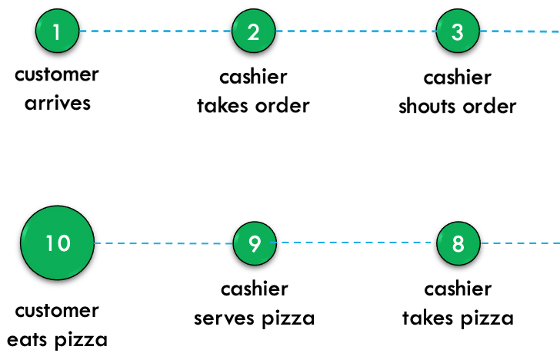
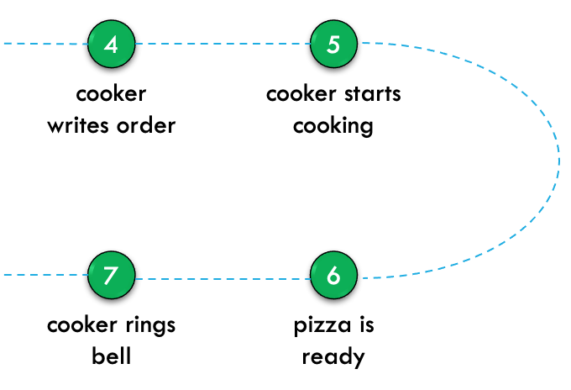
MARIO's PIZZERIA : Interview & Analysis
!
!
cooker asks to repeat
cooker understands wrong order
!
!
5 minute delay
cashier is busy taking orders
Notes:
Jason: We analysed the workflow of mario's pizzeria and this were some of the things that were influencing the workflow of the pizzeria

Slide 6
the causes?
1
Inefficient Communication
2
Overwhelming WOrkload
3
Bad ordering system
Notes:
Jason

Slide 7
SOLUTION?
1
Improves communication of orders
2
REDUCES WORK FOR CASHIER
3
Better ordering system for customer
Notes:
Jason: We proposed and developed this badass solution which is

Slide 8
NECESSARY STEPS TO IMPLEMENT SOLUTION
Planning Phase
Implementing Solutions Phase
1
Interview stakeholders
6
Start coding for Website
2
Gather user requirements
7
Implement Flask for Backend
3
Create Process Diagram
8
Implement CSV & Arduino
4
Project plan & deliverables
9
Debugging & User Testing
Prototype
10
Presentation
5
Notes:
Ruben: There are precise steps we decided were necessary in order to deliver a good and working product. The first thing we have done is interviewing stakeholders, then we gathered user requirements …..

Slide 9





tools
Notes:
Ruben: To develop our product we had to use some tools… these are: Monday.com to set deadlines for the steps we discussed in the previous slide, discord to communicate, git to share the code, visual studio code as code editor, and Figma to produce the prototypes.

Slide 10




Languages
Notes:
Ruben: The main language we used was Python, enhanced with flask to make it work with html, CSS and csv to store the data

Slide 11
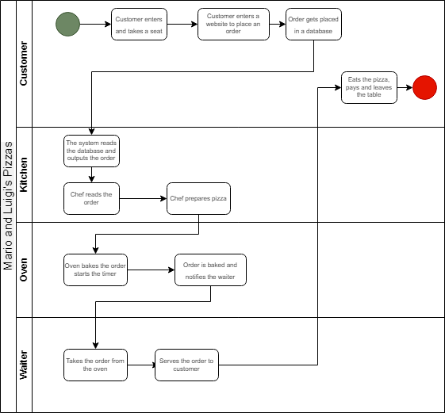
Business Process Diagram
Notes:
Nadiem: We created this process diagram that describes in simple steps how the solution should work

Slide 12
Pizzeria diagram
1
Customer enters
2
Sits at a table
cash
desk
4
main
entrance
1
3
Order on phone
kitchen
4
Pizzaiolo cooks
5
5
Cashier takes pizza from Pizzaiolo
2
3
6
dining room
Cashier serves the pizza
toilet
6
Notes:
Nadiem: This diagram instead shows the steps inside mario’s pizzeria

Slide 13
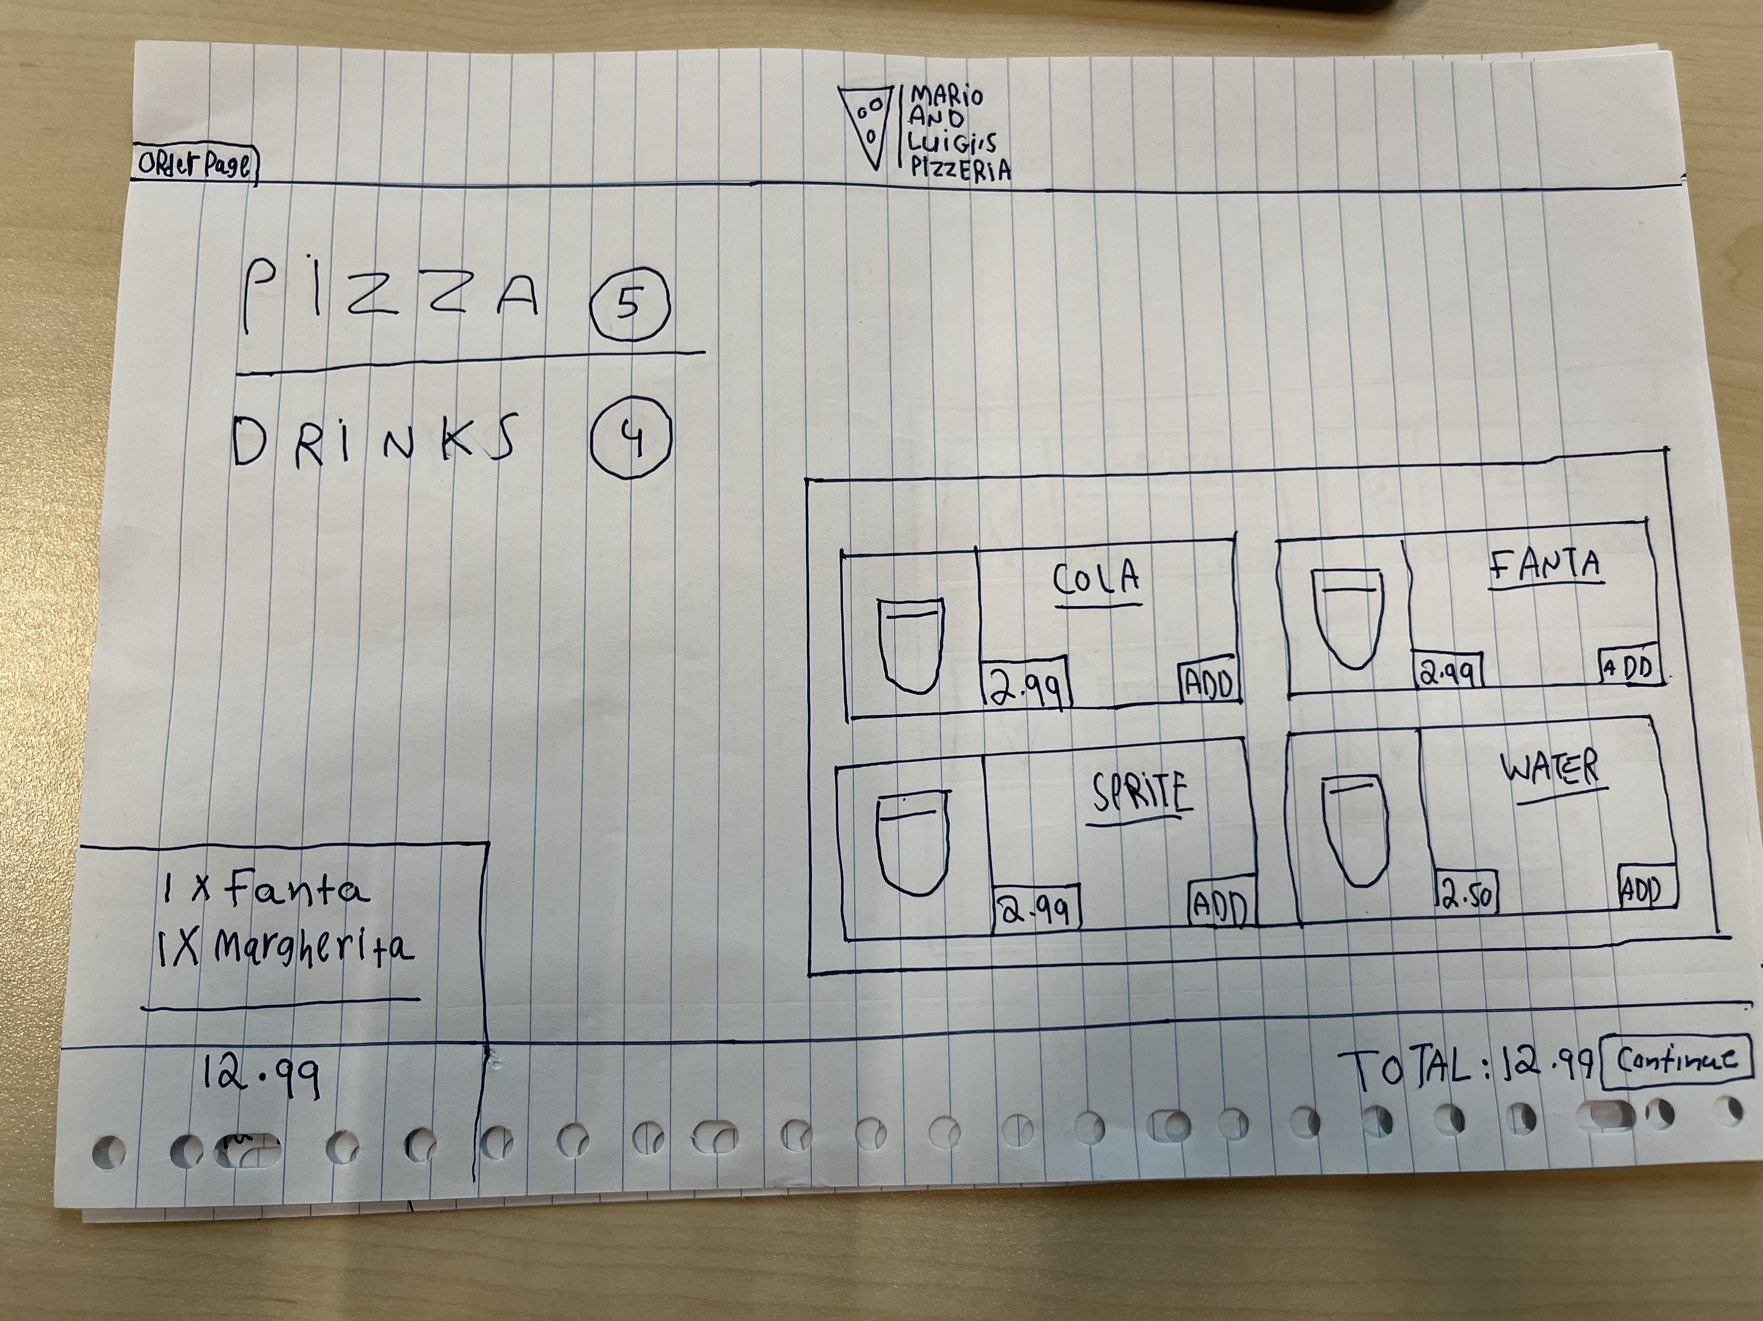
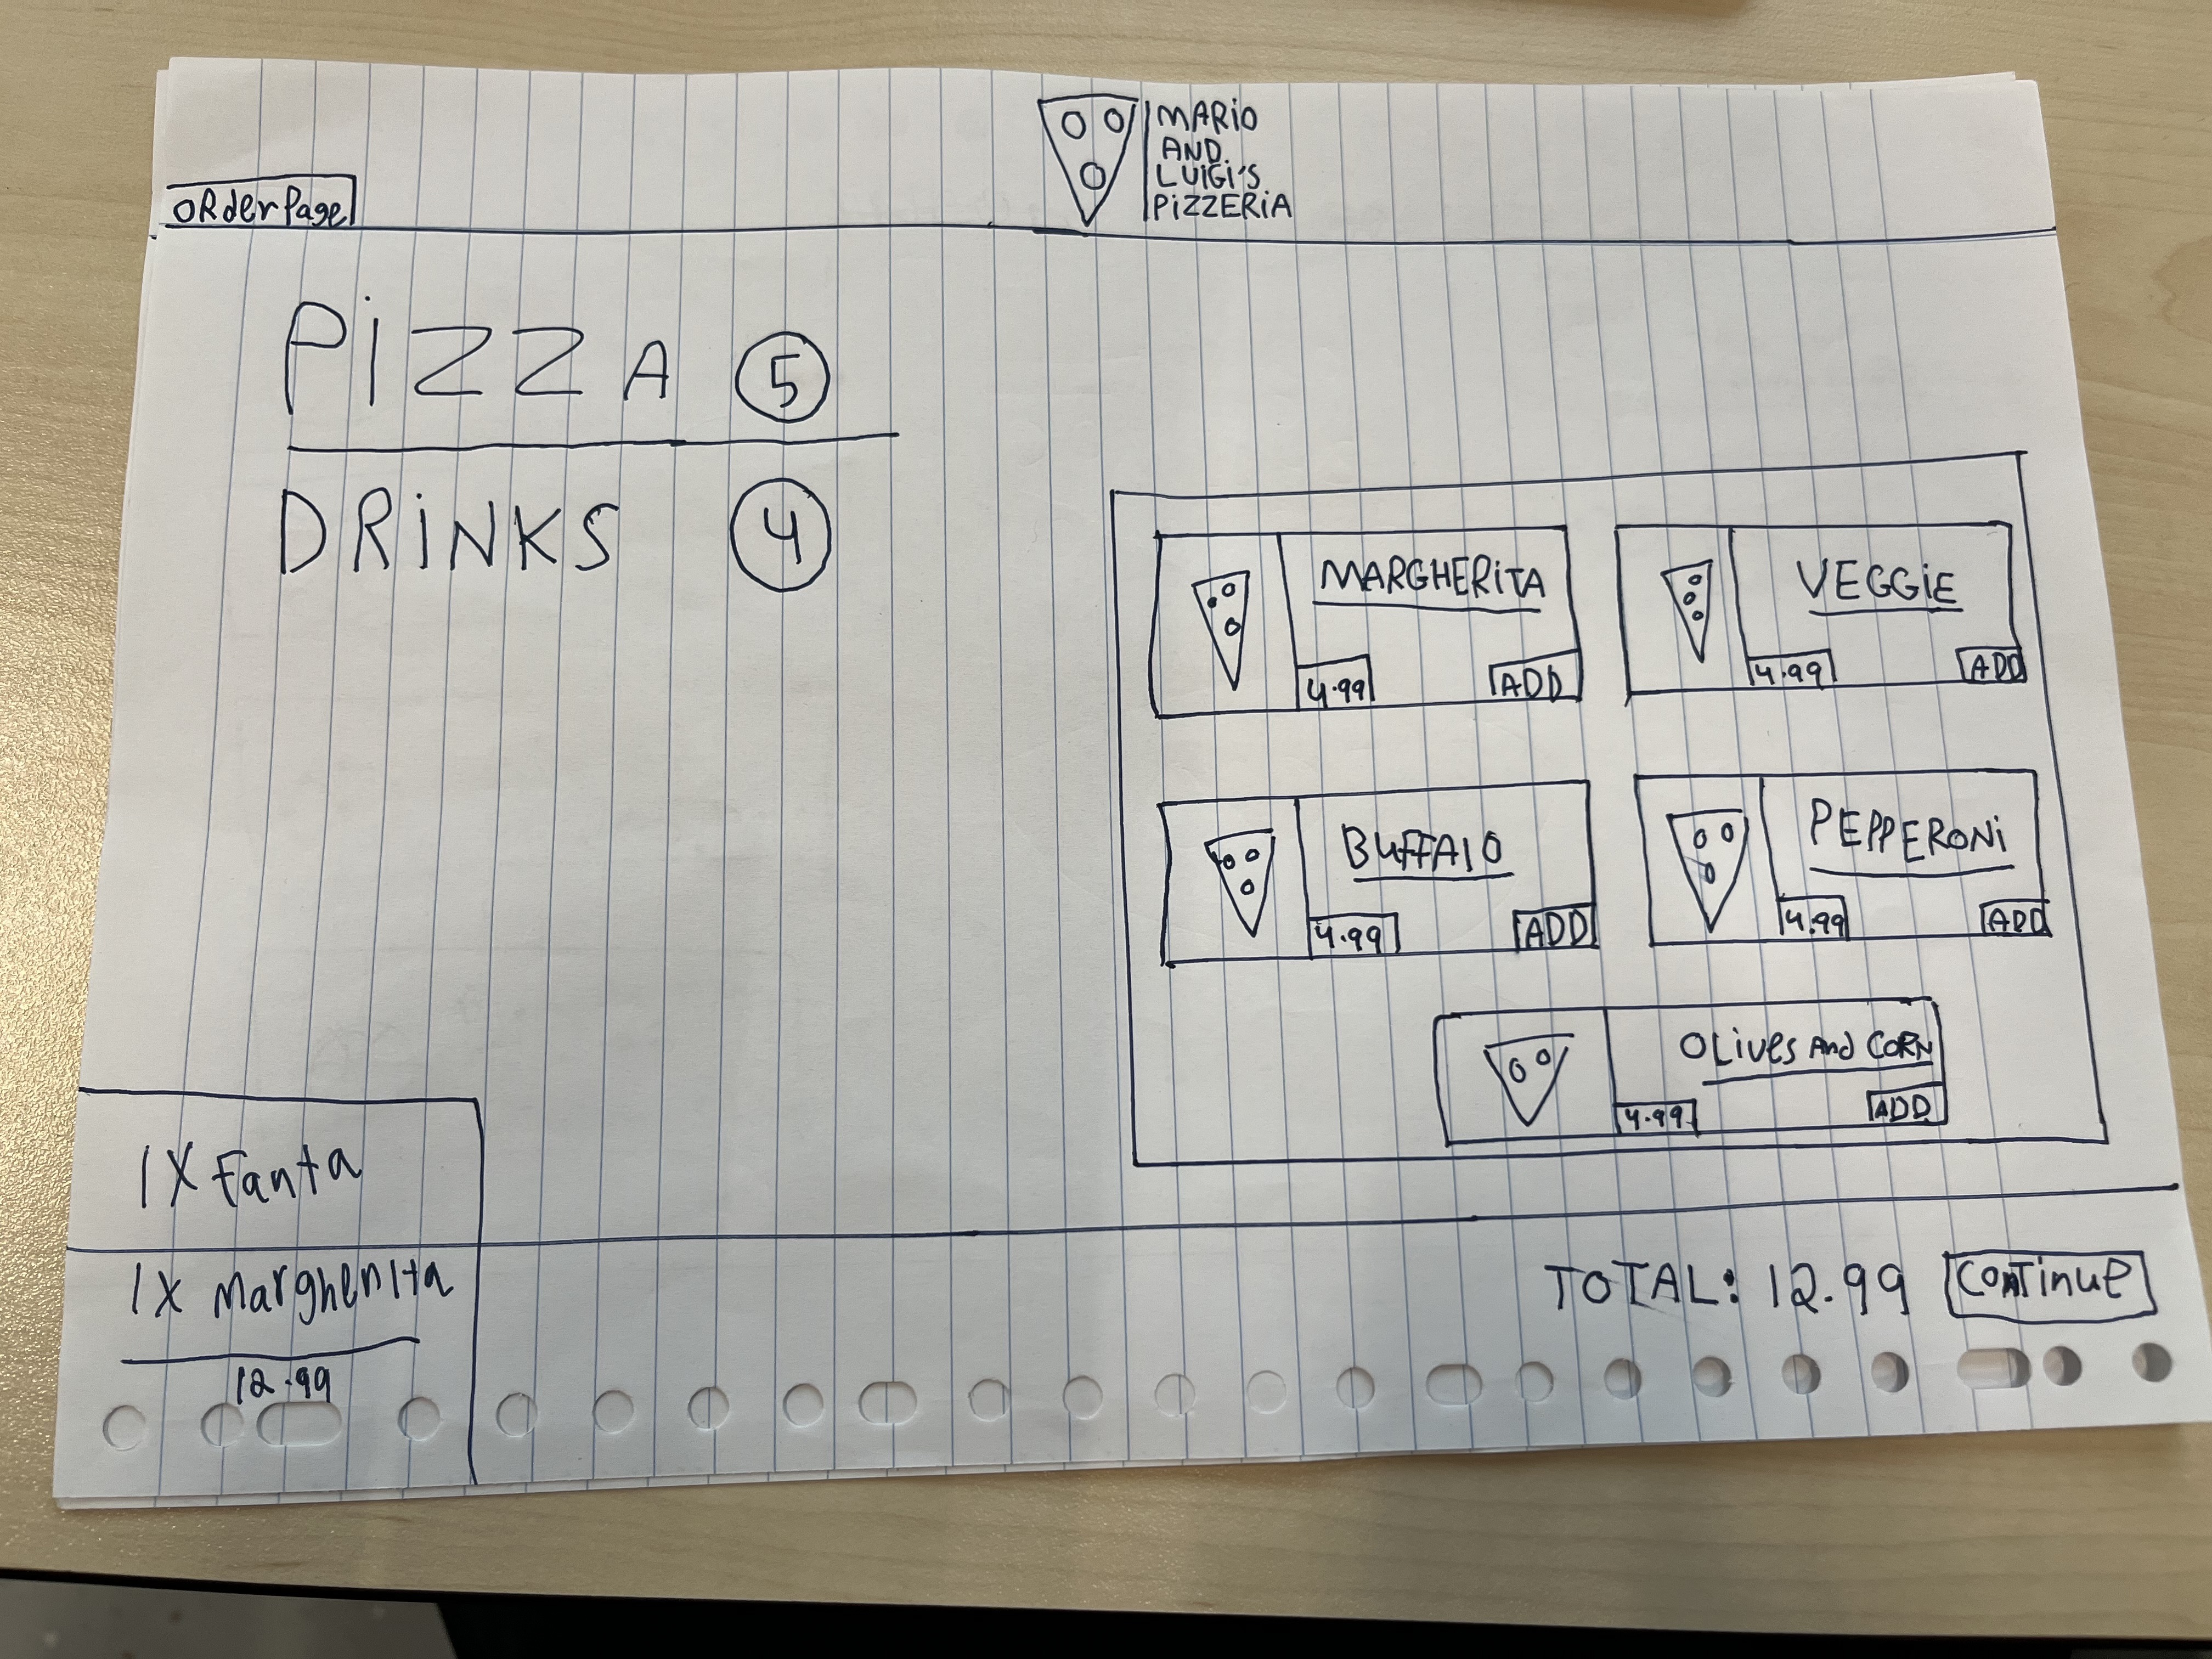
OUR PROTOTYPE: CUSTOMER’s VIEW
Notes:
Nadiem: This was our prototype when we first thought of our solution. As we can see there is the customer’s view where he can add an order.

Slide 14
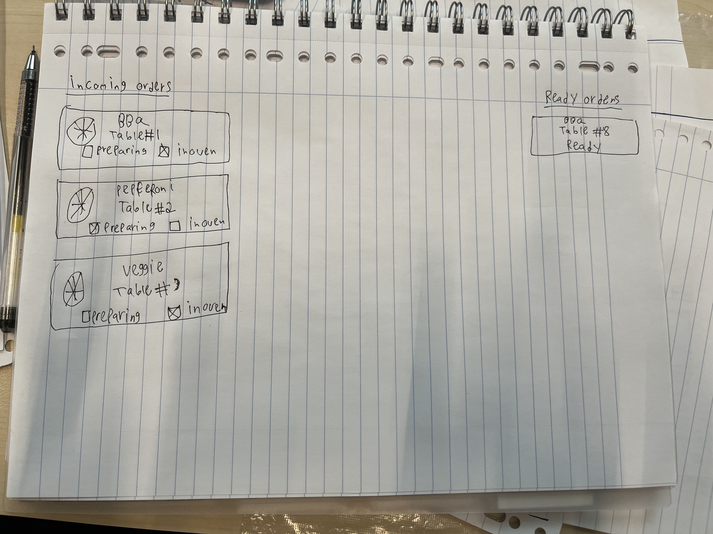
OUR PROTOTYPE: Pizzaiolo’s VIEW
Notes:
Nadiem: And the Pizzaiolo’s view will looks like this

Slide 15
Improvements FROM PROTOTYPE
1
Ordering system
2
Database
3
Workflow and Communication
Notes:
Ruben: We managed to do many improvements after we starting coding, such as … and most of these weren't even on our prototype

Slide 16
DEMO TIME
Notes:
Dimitar: SHOW THE FEATURES

Slide 17
“
"Unless you are a pizza, the answer is yes, I can live without you." - Bill Murray
"I want pizza with my face on it."
- Jennifer Lawrence
Notes:
Jason: read the quotes

Slide 18
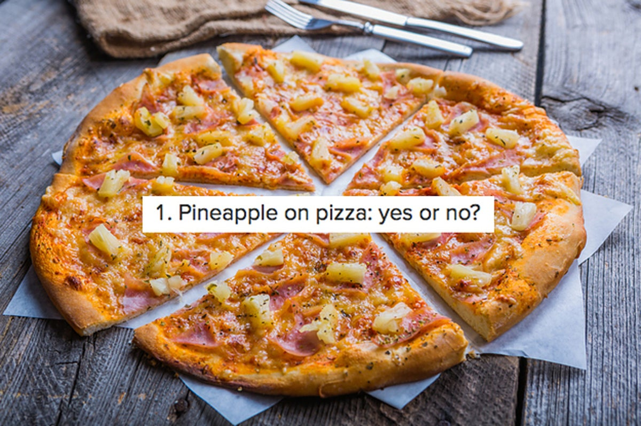
Any questions?
This is a joke right?
Notes:
Ruben: Hope we don't have to respond to this question, if you have any question about our project this is the time

